Slide 1
Weekly Lesson Plan THEME: Transportation
 | Theme & Letter | Language & Literacy | Math | Music & Movement | ART | Story Time | Sharing Time/ Misc.
MON | Intro to Transportation T is for Transportation Letter sound /t/ Handwriting Decorate: Train tracks | Beginning Sounds Game: Drive the Ice Cream Truck Timer https://www.youtube.com/watch?v=79QhWyLz4dI | Count and Graph | Let’s Be Planes song https://www.youtube.com/watch?v=YU8VOhXpLi0 | Car Wash paper printable | All Through My Town by Jean Reidy | How do you get around town?
TUE | L is for Land Vehicles Letter sound /l/ Handwriting Decorate: toy car tracks | Blending with /l/ La Le Li Lo Lu | School Bus Ten Frames - Number Recognition and Counting | 1,2,3 Red Light game Song- https://www.youtube.com/watch?v=xoyEDrMDirA | Toilet Roll Car | Pete the Cat, Go Pete Go by James Dean | Have you ever been in a train? subway? bus?
WED | A is for Air Vehicles Letter sound /a/ Handwriting Decorate blue with cotton clouds | Two Vowels Walking Rule | Hot Air Balloon – Count, Cut and Paste sheet | The Airplane song https://www.youtube.com/watch?v=ogrjr0HEZgE | Hot Air Balloon dot painting craft | Amazing Airplanes by Tony Mitton | Have you ever flown in an airplane? Where did you go?
TH | W is for Water Vehicles Letter sound /w/ Handwriting Decorate: water color paints | Ending Sounds | Number Sequence Sailboats | Row Row Row Your Boat song https://youtu.be/k50nwLbnDe8?t=5 | Egg Carton Boat | Old MacDonald Had a Boat by Steve Goetz | Have you ever been in a boat? Did you enjoy it?
FRI | R is for Rocket Letter sound /r/ Handwriting Decorate black light night sky | Review the letters we learned this week and their sounds | I Spy Math Sheet | Zoom Zoom Zoom, We’re Going to the Moon song https://www.youtube.com/watch?v=DEHBrmZxAf8 | Homemade Rocket using a straw | Edward Built a Rocketship by Michael Rack | Show-N-Tell
*Affiliate links

Slide 2
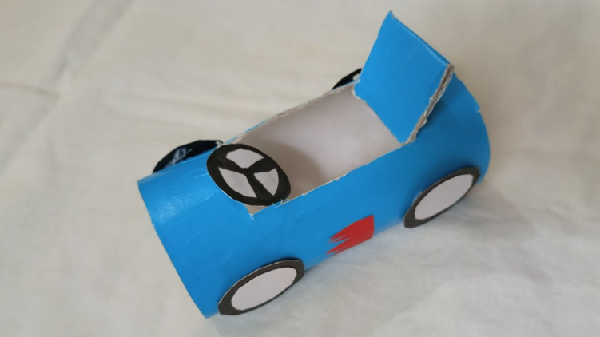
Supplies: (optional)
Monday – car wash
Paper car wash printable or piece of white paper, scissors, small box such as a cracker box
Tuesday – toilet roll car
Empty toilet roll, paint or markers, paper, scissors
Wednesday – hot air balloon
Hot air balloon printable or draw one, cotton balls and clothes pin or dot markers, paint
Thursday – egg carton boat
egg carton-half, straw, paper for sail
Friday – homemade rocket
Rocket printable (or draw one),
paper, tape, scissors, straw

Slide 3
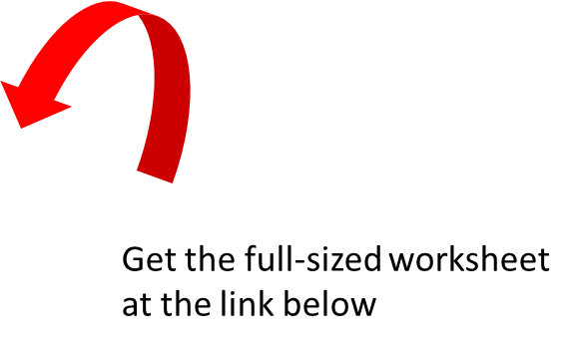
Monday-Math
https://www.schooltimesnippets.com/2017/11/transportation-graphing-worksheet.html
Note: This worksheet is different from the one shown in my YT video. I could
no longer find the original worksheet.

Slide 4
Monday-Art
https://www.teacherspayteachers.com/Product/Transportation-Preschool-Kindergarten-Activities-Fine-Motor-Skills-4287004?gclid=Cj0KCQjwtvqVBhCVARIsAFUxcRv-IpGnvAreK9u9EnN-gKVcealhVvXmK4zJBUb6trbvPjtjWzuAoD4aAkiYEALw_wcB
*This worksheet is in a set for $4. You could also use a piece of regular paper
and cut straight lines. Most of the worksheets I share are FREE, but this one was
so cute!

Slide 5
Tues - Math
https://www.teacherspayteachers.com/Product/Transportation-Math-Worksheets-for-Preschool-and-Kindergarten-5625056
*This worksheet is in a set for $5.50. You could also just print pictures of kids
and draw your own ten frame.

Slide 6
Wed - Math
https://www.homeschoolshare.com/hot-air-balloons-count-clip-cards/
Note: This worksheet is different from the one shown in my YT video. I could
no longer find the original worksheet.

Slide 7
Wed - Art

Slide 8
Thurs - Math
Number Sequence 1-10
Cut and paste the sailboats according to the right number sequence.
1
3
5
6
8
10
2
4
7
9

Slide 9
Fri - Math
https://taminglittlemonsters.com/space-i-spy/
Note: This worksheet is different from the one shown in my YT video. I could
no longer find the original worksheet.

Slide 10
Fri - Art
https://buggyandbuddy.com/straw-rockets-with-free-rocket-template/

Slide 11
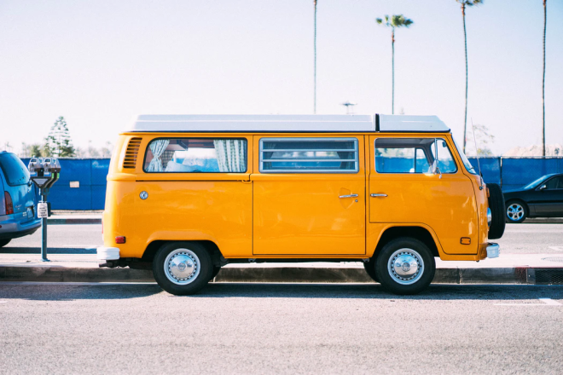
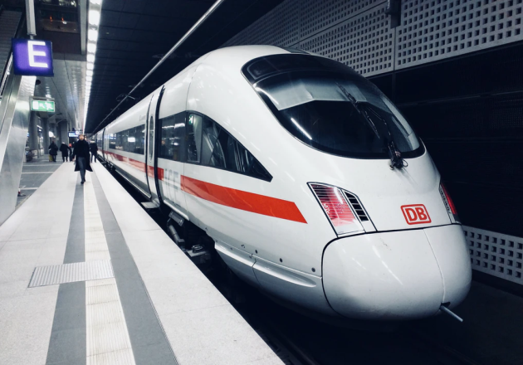
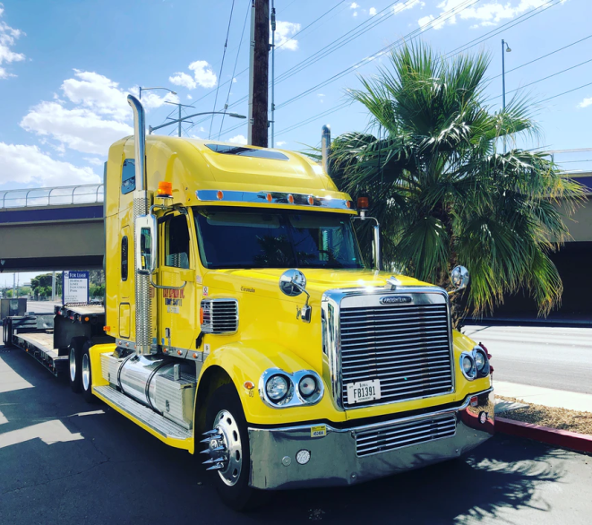
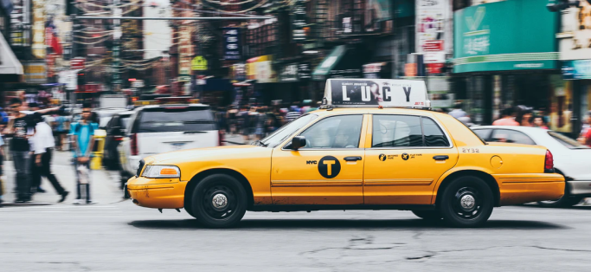
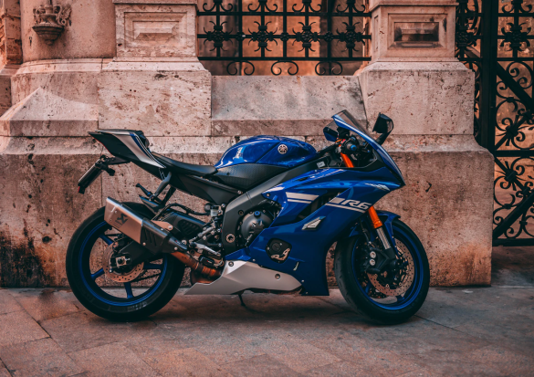
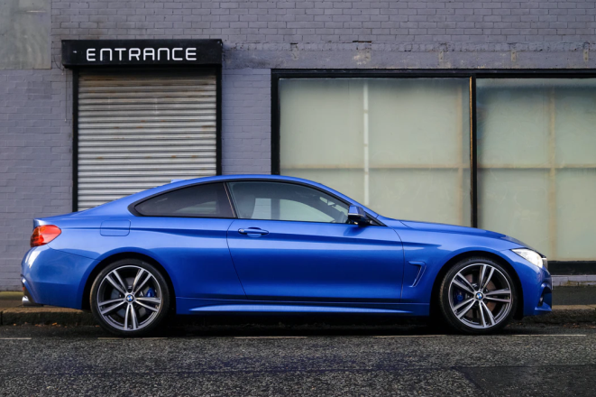
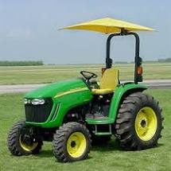
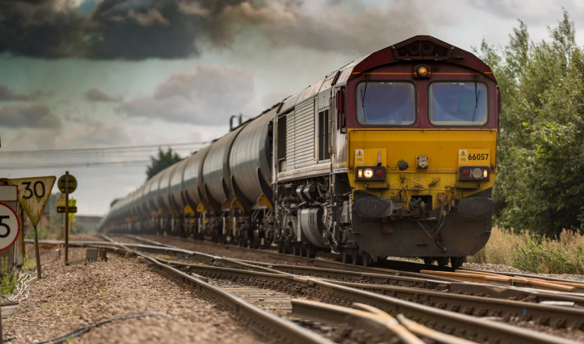
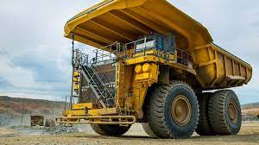
Land Vehicles

Slide 12
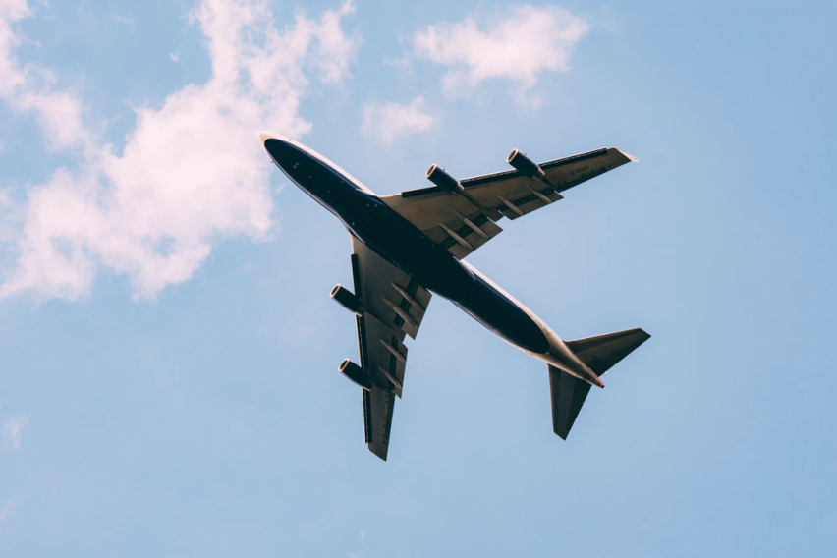
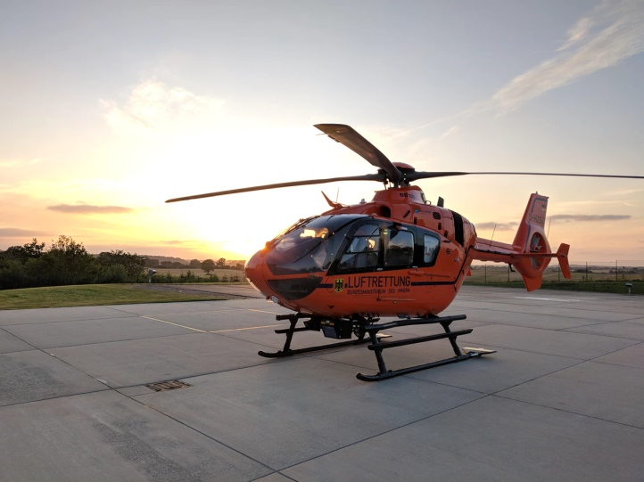
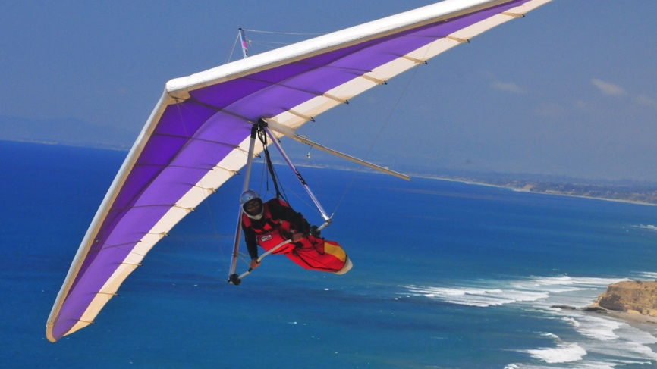
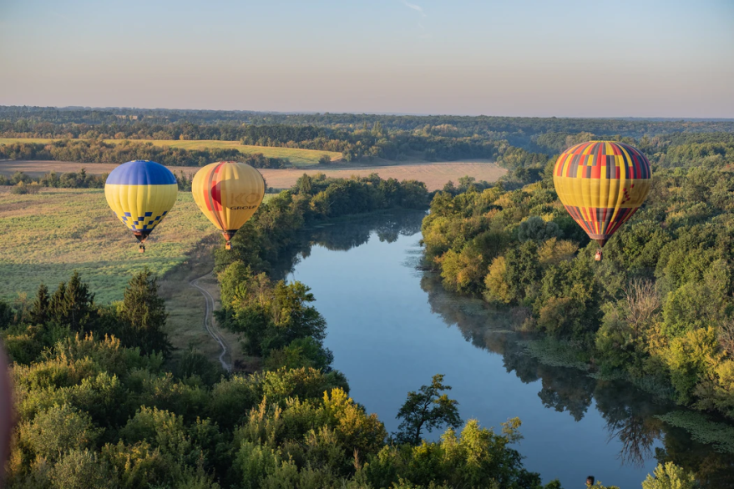
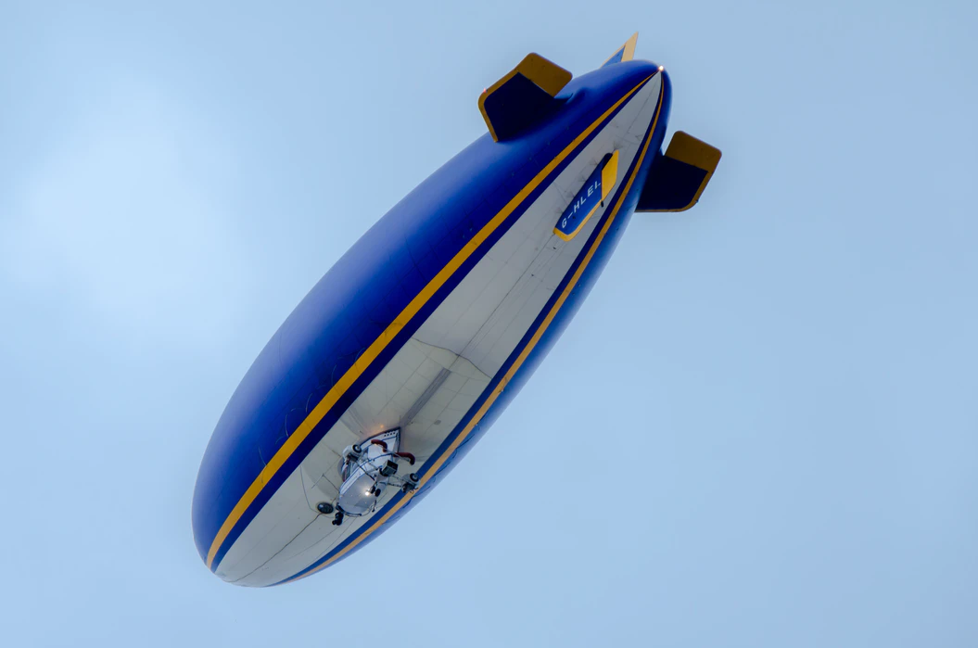
Air Vehicles

Slide 13
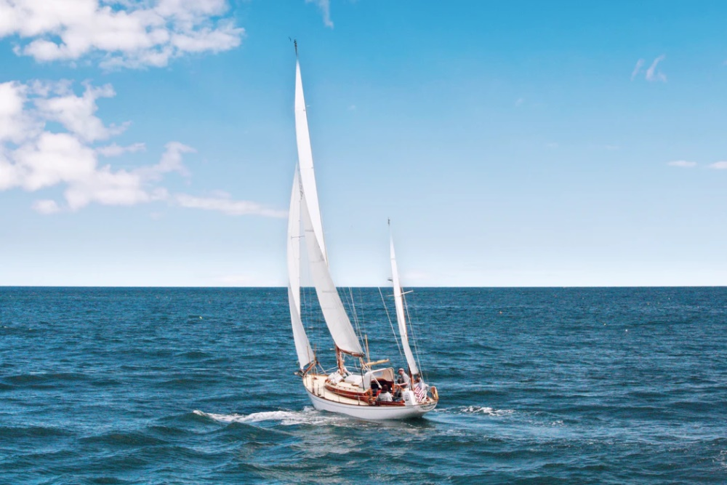
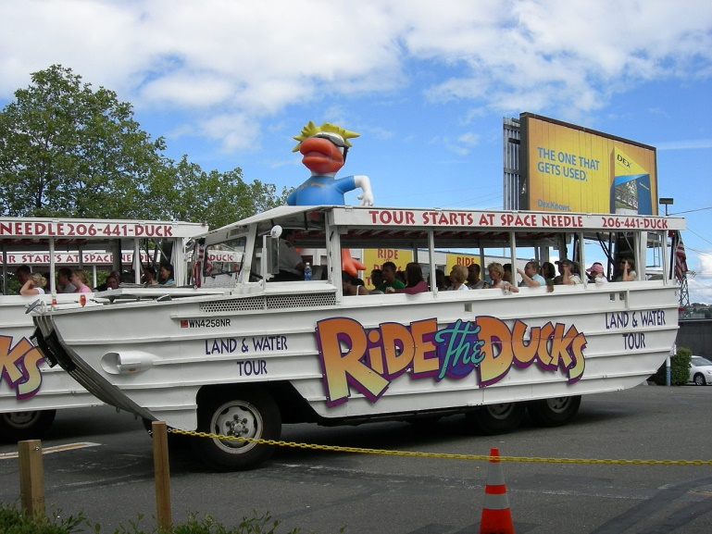
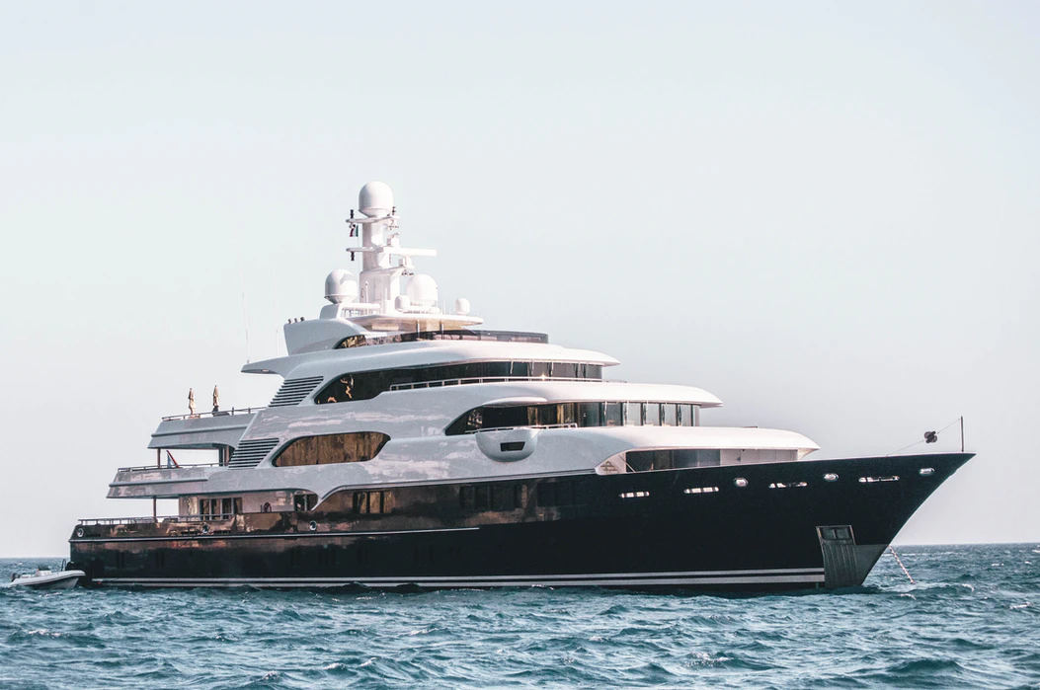
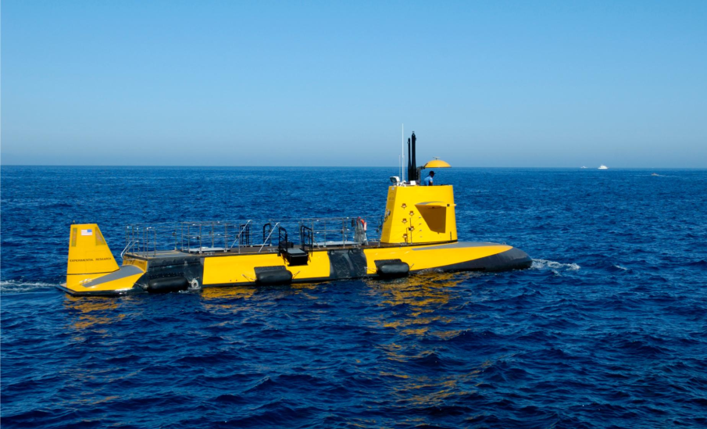
Water Vehicles

