Slide 1
Weekly Lesson Plan THEME: SPACE
 | Theme & Letter | Language & Literacy | Math | Music & Movement | ART | Story Time | Sharing Time
MON | Introduce the Space theme R is for Rocketship Letter sound Handwriting | Sh says /sh/ as in ship Read: ship shop sham shack | Number order (BOOM Cards $5) https://www.teacherspayteachers.com/Product/Space-Theme-Numbers-to-10-Boom-Cards-Distance-Learning-Kindergarten-5846890?st=01bb5da2c71d98040d176aa6d9196f9c | Countdown to Blastoff https://www.youtube.com/watch?v=Sqm-kFNaw8c | Shape paper rocket | Sadie Sprocket Builds a Rocket by Sue Fliess | What are some things in space?
TUE | A is for Astronaut Letter sound Handwriting | Letter Recognition –Find the astronaut https://www.teacherspayteachers.com/Product/Digital-Literacy-Game-Space-Letters-and-Sight-Words-for-Google-6770890 | Space Ordinal Numbers (BOOM Cards-above link) | Astronauts song https://www.youtube.com/watch?v=HSYaEBcl8xI | Space Playdough | Mousetronaut by Mark Kelly | Would you want to be an astronaut?
WED | S is for Stars Letter sound Handwriting Show how to draw star | Blending- Sa Se Si So Su | How Many More Stars Makes Ten (BOOM Cards-above link) | Twinkle Twinkle, Little Star https://www.youtube.com/watch?v=EGSOX9F0PC8 | Star Mobile | Peppa in Space by Scholastic | Do you ever go outside and look at the stars at night?
TH | P is for Planets Letter sound Handwriting | Count the Syllables - Space Themed Words (on screen) | Find, Count and Write sheet | Planet Song https://www.youtube.com/watch?time_continue=26&v=noiwY7kQ5NQ&feature=emb_logo | Planet earth balloon stamping (or use ball) | Pete the Cat Out of This World by James Dean | Discuss the 9 planets.
FRI | C is for Constellations Letter sound Handwriting | CVC Words - Space theme (on screen) | Counting to 10 and picking the correct number (on screen) | Constellations song https://www.youtube.com/watch?v=nvDosSr69zA | Paper Cup Constellation viewer | Curious George Discovers the Stars by H.A. Rey | Show-n-tell
*Affiliate links

Slide 2
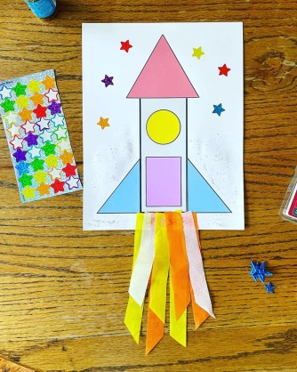
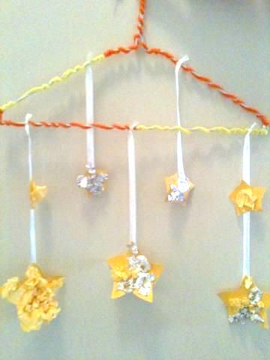
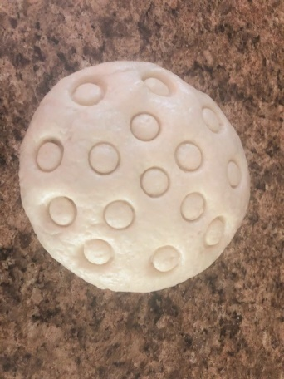
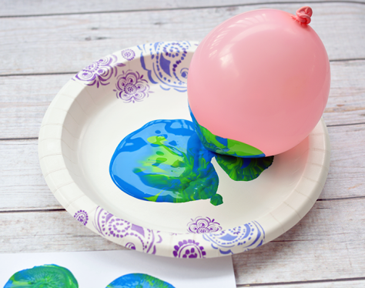
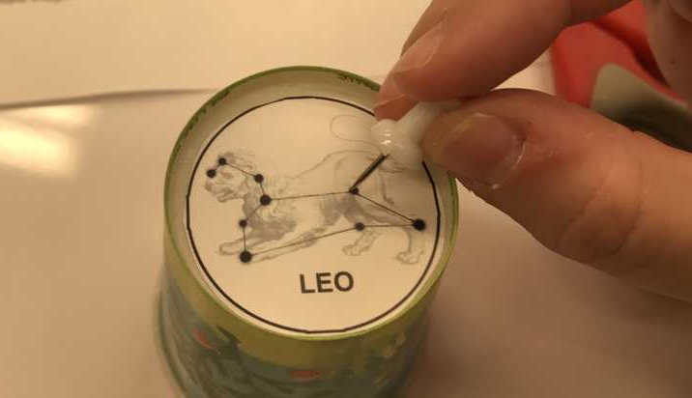
Supplies: (optional)
Monday
Decorate letter R like a rocketship using markers
Copy of rocket shape sheet (or draw your own shapes), crayons/markers, glue, scissors
Tuesday
Decorate A with tin foil like an astronaut
Art – Space Playdough
Recipe
1 1/2 cup flour
1/2 cup salt
1/2 cup water
(add more water if it’s too crumbly)
Wednesday
Decorate S with star stickers
Clothes hanger, string, yellow paper stars (or white)
*The picture shows the hanger has been decorated with pipe cleaners, but I will leave the hanger plain
Thursday
Decorate P with tissue paper
Art-Balloon or bouncy ball, paper plate, blue and green paint
Friday
Decorate C with black crayon and white paint dots using Qtip
Art-paper cup (or toilet roll), thumbtack
*Parent will need to supervise the thumbtack

Slide 3
Mon - Art
Get this worksheet here:
https://thehollydogblog.com/rocket-ship-craft/
*FREE resource

Slide 4
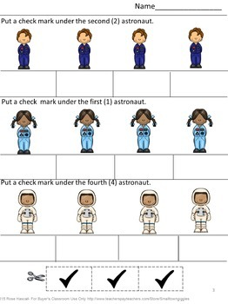
Tues - Math
Get this worksheet here:
https://www.teacherspayteachers.com/Product/Free-Sampler-Outer-Space-Math-Worksheets-Ordering-Numbers-Ordinal-Numbers-1965334
*FREE resource

Slide 5
Wed - Math
Get this worksheet here:
https://www.themeasuredmom.com/how-many-to-10-clip-cards/
*FREE resource

Slide 6
Get this worksheet here:
https://www.reallifeathome.com/space-preschool-kindergarten-math-worksheets/
*FREE resource

Slide 7
Get this worksheet here:
https://www.ecpubliclibrary.info/wp-content/uploads/2022/03/Constellation-Projectors.pdf

