Slide 1
Weekly Lesson Plan THEME: DINOSAURS
 | Theme & Letter | Language & Literacy | Math | Music & Movement | ART | Story Time | Social Skills
MON
TUE | Intro to Dinosaur theme D is for Dinosaur Letter sound /d/ Handwriting | Identify objects that start with d - worksheet | Dinosaur Measuring | Move Like a Dinosaur song https://www.youtube.com/watch?v=n1HT7CWG7F8 | Standup Dinosaur with2 toilet roll legs | How to Catch a Dinosaur | Have you ever seen a movie with dinosaurs in it?
WED | E is for Egg/Extinct Letter sound /e/ Handwriting | Er, ir, ur all say “Errrr” like a dinosaur | Greater than/less than w/ dinosaur mouth (on screen activity) | I’m Bringing Home a Baby Dinosaur song https://www.youtube.com/watch?v=n15mtxCim3U | Paper plate dinosaur egg | The Super Hungry Dinosaur | What would you do if you found a dinosaur egg?
TH | V is for Volcano Letter sound /v/ Handwriting | Phoneme substitution | Patterns | Ten Little Dinosaurs https://youtu.be/TjmGTbNLj6Q | Dinosaur silhouette art | Ten Little Dinosaurs | Do you have any toy dinosaurs? How many?
FRI | F is for Fossil Letter sound /f/ Handwriting | Fossil Find letter recognition | Dinosaur Subtraction (on screen activity) | Dinosaur Stomp song https://www.youtube.com/watch?v=gzesbQaqhCY | Dinosaur Dig in a baggie | Have you Seen my Dinosaur? | Show-N-Tell
- - - - No Class - - - -

Slide 2
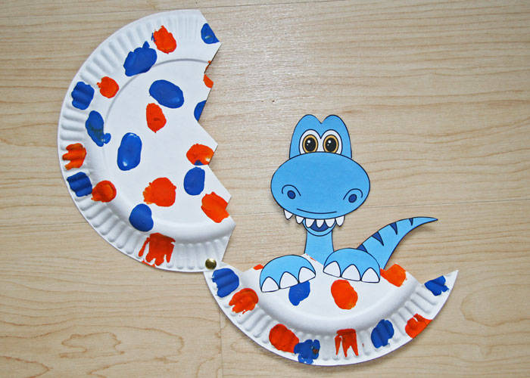
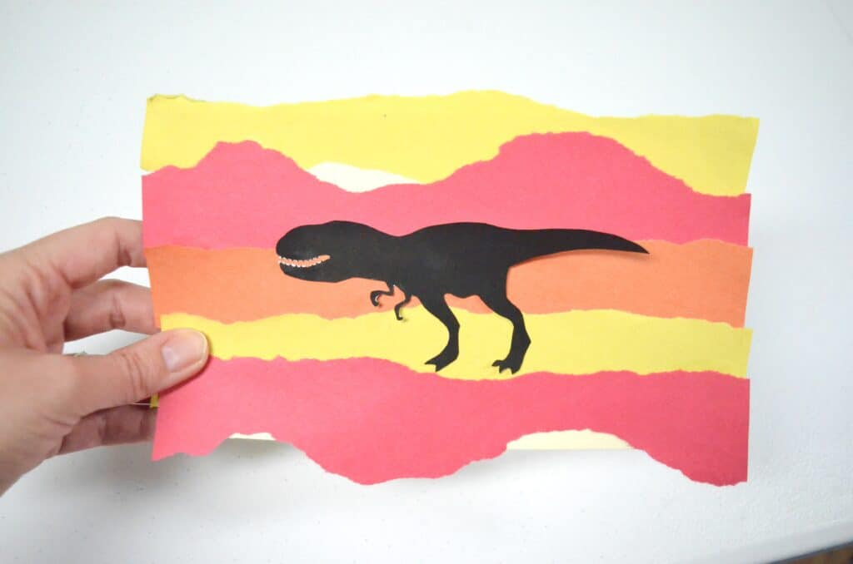
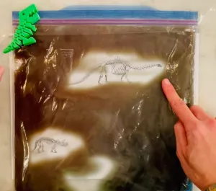
Supplies: (optional)
Monday – No Class
Tuesday
paper dinosaur printable (or draw your own), 1 toilet roll, scissors, crayons
Wednesday
paper plate, scissors, brad
Thursday
Red, yellow, orange & white paper, dinosaur silhouette printable or black paper to make your own, scissors
Friday
Dinosaur bones printable, large Ziplock bag, Clear Hair Gel (or any liquid like shampoo, conditioner, lotion or dish soap will work, several colors of food coloring (Note: If you mix them the colors all together, they make brown) OR use brown paint OR chocolate pudding…

Slide 3
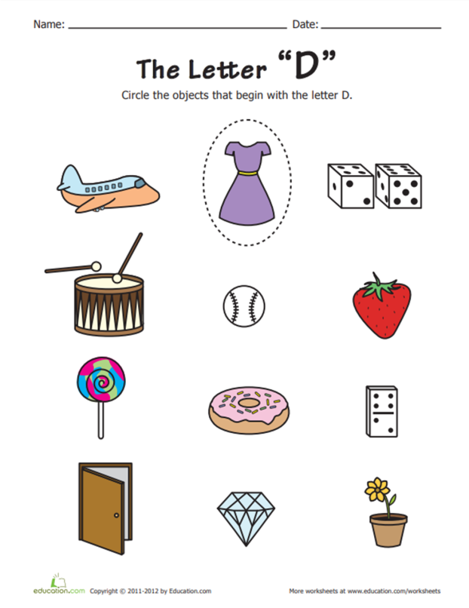
Mon - Language
Get the full sized worksheet here:
https://www.education.com/worksheet/article/alphabet-phonics-d/

Slide 4
Mon - Art

Slide 5
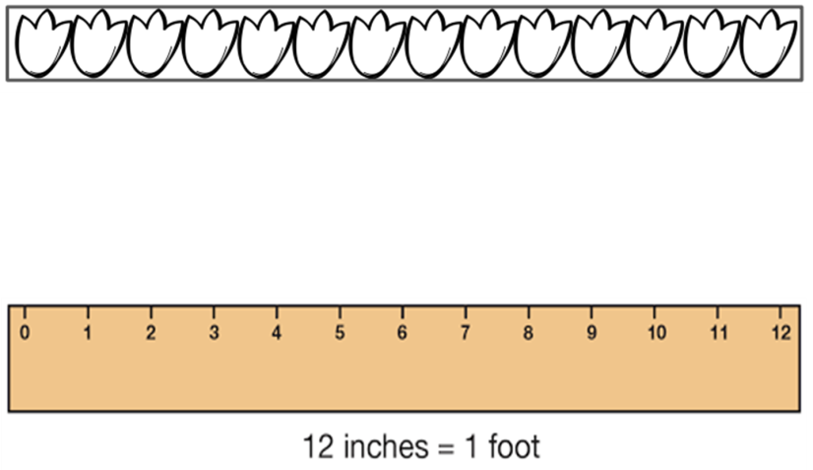
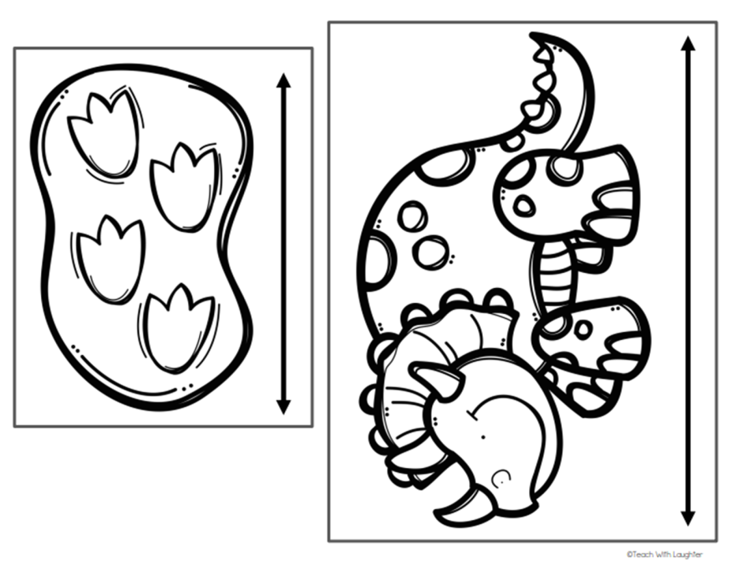
Tues - Math
https://www.teacherspayteachers.com/Product/Dinosaur-Measuring-1859643?st=7a23b6bab7f854c1ec0f0dc6c696f5cf

Slide 6
Wed - Art
Get the full sized worksheet here:
Source: https://www.dltk-kids.com/t.asp?t=https://www.dltk-kids.com/animals/dinosaurs/images/b-hatching-brontosaurus.gif

Slide 7
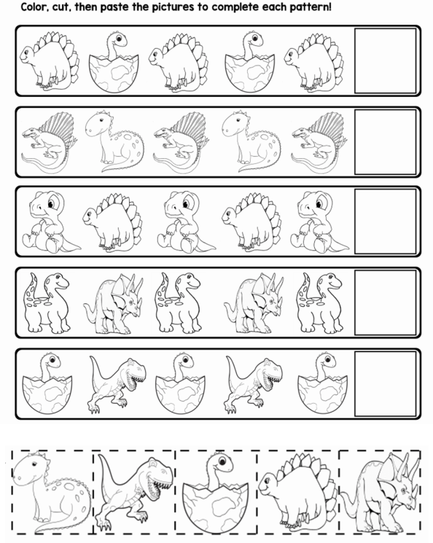
Thurs - Math
Get the full sized worksheet here:
https://www.teacherspayteachers.com/Product/Dinosaur-AB-Pattern-Worksheets-5-Pages-3672243

Slide 8
Thurs - Art
Get the full sized worksheet here:
https://www.survivingateacherssalary.com/dinosaur-art-activities-for-kids/

Slide 9
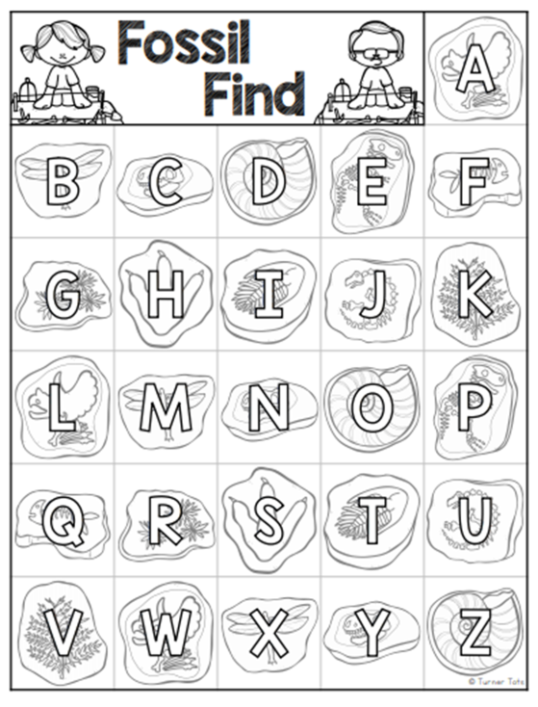
Friday
Get the full sized worksheet here:
https://www.teacherspayteachers.com/Product/Fossil-Find-Alphabet-Matching-Activity-4017410?st=5938fe07c81ae695ff0eef483b09f998

Slide 10
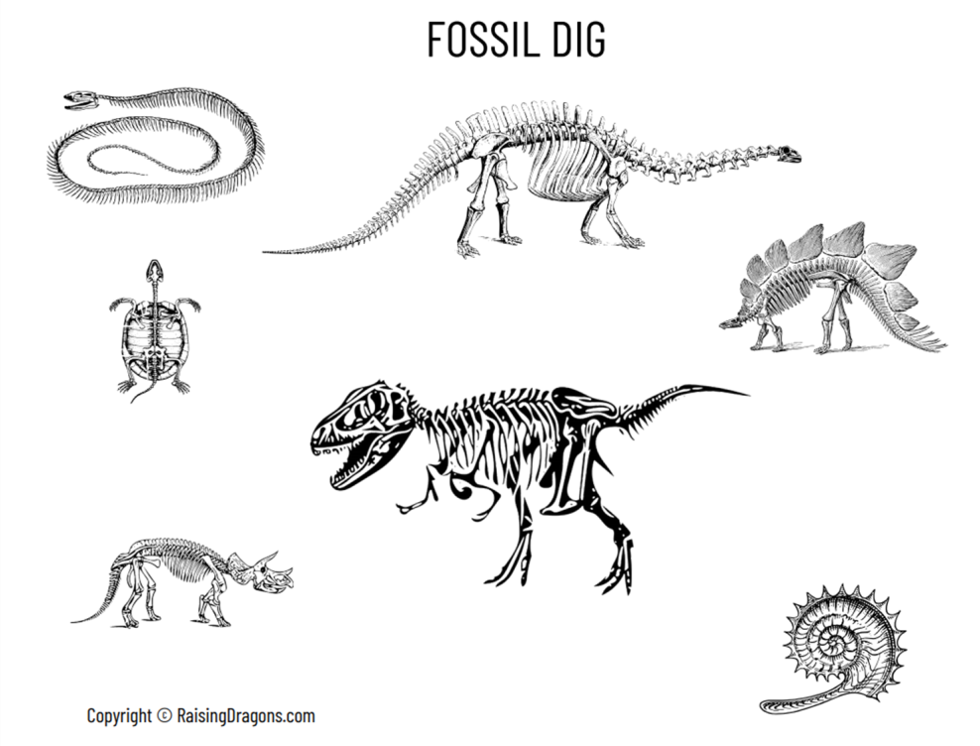
Fri - Art
Get the full sized worksheet here:
Source: https://www.raisingdragons.com/fossil-dig-dinosaur-sensory-bag/

