Slide 1
Weekly Lesson Plan THEME: BUGS
 | Theme & Letter | Language & Literacy | Math | Music & Movement | ART | Story Time | Sharing Time
MON | Intro to Bugs theme B is for Insects Letter sound /b/ Handwriting | Begins with B sheet | Addition – Adding bugs to a Ten Frame | Do the Insect Dance https://www.youtube.com/watch?v=1IDTP8ztRFc | Bug fingerprint jar | Bugs Bugs Bugs by Bob Barner | All week feel free to bring a bug that you find to class and show your friends!
TUE | Z is for Buzz Letter sound /z/ Handwriting | Flight of the Bumblebee song with streamer (use party streamer, ribbon, or a toilet paper /ee/ as in bee, see, wee | Write the Numbers 1-10 | Where Honey Comes From https://www.youtube.com/watch?v=7WP_PnTUaTA | Honey comb hexagon | The Big Honey Hunt Bernstein Bears
WED | S is for Spider Letter sound /s/ Handwriting | Blending sa se si so su | Water Spout Adding/ Subtracting 1 | Eensy Weensy Spider song and motions https://youtu.be/bne3Ix_tJL8 | Paper Plate Spider Web | The Very Busy Spider by Eric Carle
TH | F is for Firefly Letter sound /f/ Handwriting | Firefly Letter Recognition (lower case) | Firefly Addition to Ten https://funlearningforkids.com/digital-firefly-addition-to-10-activity/ | Bug and Roll Song https://www.youtube.com/watch?v=oybEMWW23uU | Band-Aid fireflies | The Very Lonely Firefly by Eric Carle
FRI | C is for Catch Letter sound /c/ Handwriting | Syllables - clap out these words: caterpillar (4) cricket (2) grasshopper (3) Bee (1) | Insect Patterns sheet | Bugs and Crawly Things song https://www.youtube.com/watch?v=hUbYq93cYdE | Bug Observer jar | Twig by Aura Parker | Show-N-Tell
*Affiliate links

Slide 2
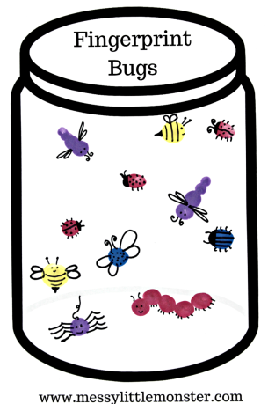
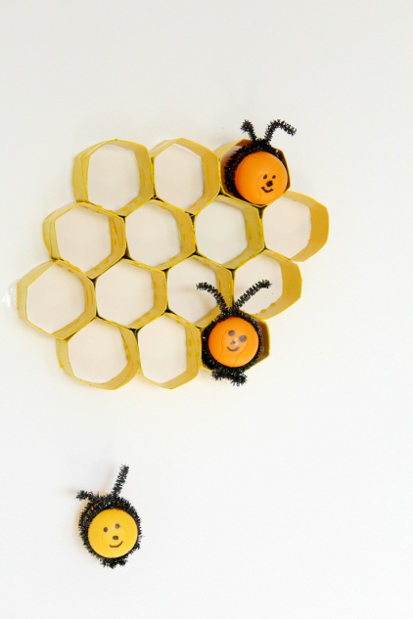
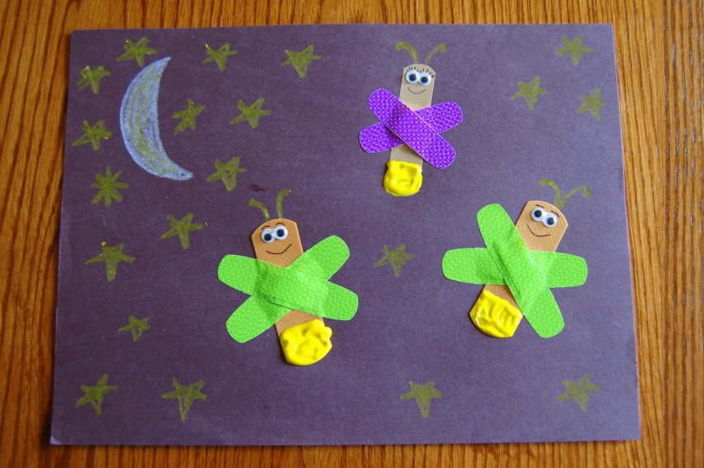
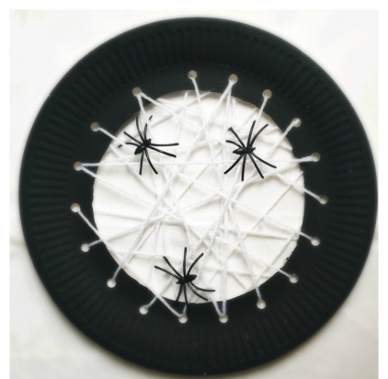
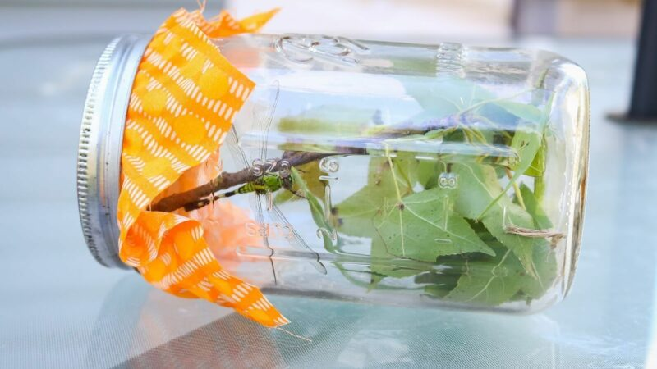
Supplies: (optional)
Monday - Bugs
Jar printable, fingerpaints, black marker
Tuesday - Buzz
toilet roll, scissors, glue, bee printable (optional)
Wednesday - Spider
paper plate, hole punch, yarn
Thursday - Firefly
Black or dark colored paper, yellow or white crayon, band-aids (Note: we will only make 2 fireflies, so we don’t waste too many band-aids! We won’t add yellow paint to the band-aid.)
Friday – Catch
Mason jar, lid, porous fabric
*Be sure to supervise since the jar is glass.

Slide 3
Monday
Get this worksheet here:
https://www.treevalleyacademy.com/letter-b-sound-worksheets/
*Freebie

Slide 4
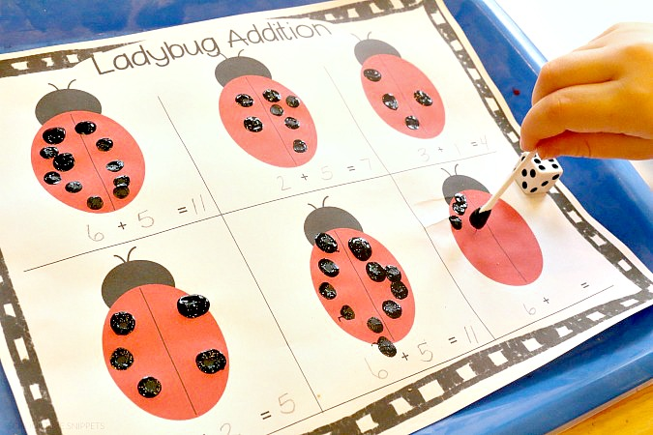
Monday
Get this worksheet here:
https://www.schooltimesnippets.com/2016/04/ladybug-addition-games-printable.html
*Freebie

Slide 5
Monday - Art
Get this worksheet here:
https://www.messylittlemonster.com/2018/03/fingerprint-bug-jar-craft-printable.html
*Freebie

Slide 6
Tuesday
Get this worksheet here:
https://www.totschooling.net/2018/08/bee-math-for-tots-and-preschoolers.html?m=1
*Freebie

Slide 7
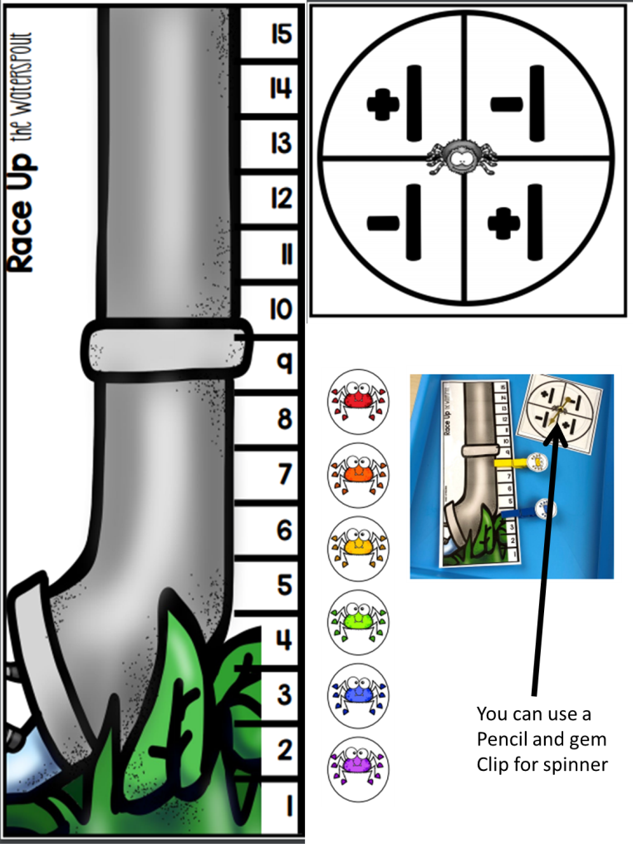
Wednesday
Get this worksheet here:
https://www.teacherspayteachers.com/Product/Nursery-Rhymes-Math-and-Literacy-Centers-for-Preschool-Pre-K-and-Kindergarten-6649969
*This resource does cost money.
You could create your own game,
if you’d rather.

Slide 8
Thursday
Get this worksheet here:
https://thekindergartenconnection.com/catch-firefly-alphabet-match/
*Freebie

Slide 9
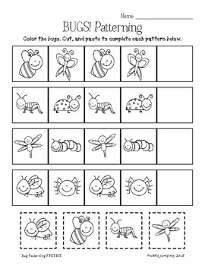
Get this worksheet here:
https://www.teacherspayteachers.com/Product/Bugs-Patterning-for-Preschool-and-Kindergarten-FREEBIE-3817768?epik=dj0yJnU9Q21sY25YR0pXeHRCYmljM1o3LTFRTGVVcDZrRDVaVjImcD0wJm49SmFuRnhFWDJ0YWZ3Ykk0SEc1OThIQSZ0PUFBQUFBR0xTc0VZ
*Freebie

