Slide 1
Weekly Lesson Plan THEME: Pirates
 | Theme & Letter | Language & Literacy | Math | Music & Movement | ART | Story Time | Social Sharing Time
MON | Intro to Pirates theme P is for Pirate Letter sound /p/ Handwriting Decorate with X marks the spot | /ar/ says “arrr” like a pirate Car Jar Far Bar Tar | Roll, Add and Color | If You Want to be a Pirate song | Pirate hook (paper cup, plastic clothes hanger or tin foil) | The Grumpy Pirate | Talk about parrots.
TUE | Y is for Yo ho ho Letter sound /y/ Handwriting Decorate w/ yarn | Ar Hunt worksheet Game: yell | Addition to 3,4,5 | Silly Pirate Song | Pirate telescope (paper towel roll) | Pirate Boy by Eve Bunting | What kinds of things might be in a treasure chest?
WED | G is for Gold/ Treasure Letter sound /g/ Handwriting Decorate with coin rubbing | Ar Find the Word (on screen game) | Basic coin identification - Add to the treasure box | Pirate Quest with map (on screen) | Treasure Map (Map –printed or drawn, instant coffee or old tea bag) | Pete the Cate Treasure by James Dean | Do you have a piggy bank? Do you have a lot of coins inside?
TH | H is for Hat Letter sound /h/ Handwriting Decorate w/ happy face stickers | Shape Reader I, see, a | Addition and Number writing (pirate’s jewels) | Pirates Looking for Treasure song | Pirate Hat craft (black and white paper, print template or draw) | Pirates Don’t Go to Kindergarten | Tell us about your favorite hat.
FRI | Q is for Quest Letter sound /q/ Handwriting Decorate with jewels | Qu are best friends and usually together in words like: quiet Quit Quilt Quest | Pirate skip counting | We are the Pirates song | Pirate Ship (pool noodle, stick, paper flag) | How to Be a Pirate By Sue Weiss | SHOW-N-TELL

Slide 2
Supplies: (optional)
Monday – pirate hook
1 paper cup, plastic clothes hanger (Adult, snap the hook part off) OR kitchen foil – I will show how to use either
Tuesday – pirate telescope
1 paper towel roll or rolled up paper, black crayon, yellow paper, glue (OR you could use paint)
Wednesday – old treasure map
Print the treasure map OR bring white paper and a marker and I will show you how to draw one, old coffee grounds and water OR old tea bag – I’ll show how to use either to make the map look old
Thursday – pirate hat
Print the pirate hat pattern OR just trace it from the screen onto white paper, scissors, crayons
Friday – pirate ship
Small piece of pool noodle OR small plastic container that will float, straw or pencil, black paper, white crayon or chalk

Slide 3
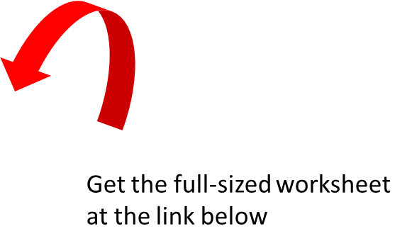
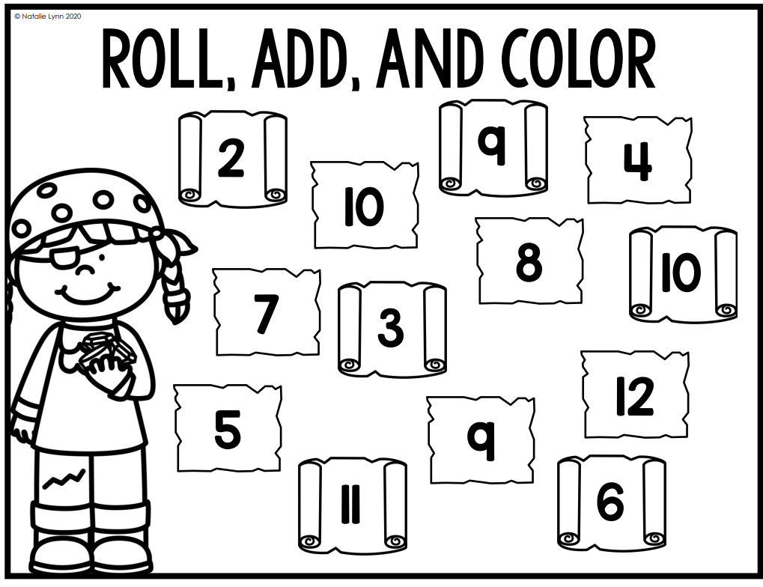
MONDAY
https://natalielynnkindergarten.com/lets-have-a-pirate-day-in-kindergarten/

Slide 4
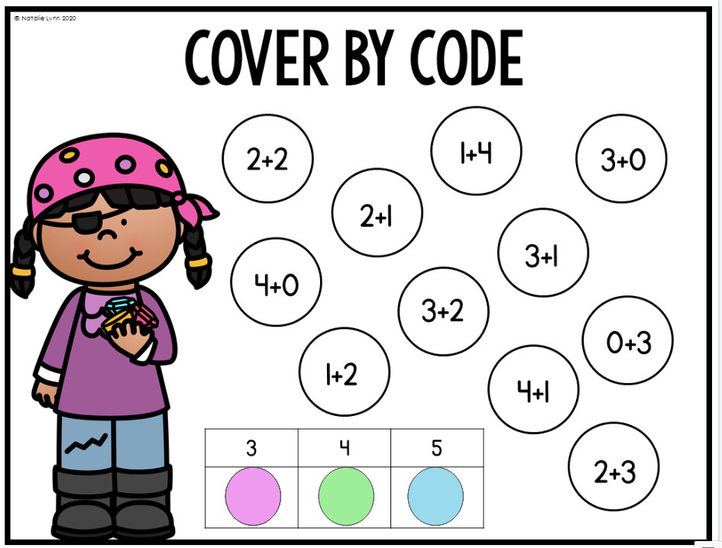
TUESDAY
https://natalielynnkindergarten.com/lets-have-a-pirate-day-in-kindergarten/

Slide 5
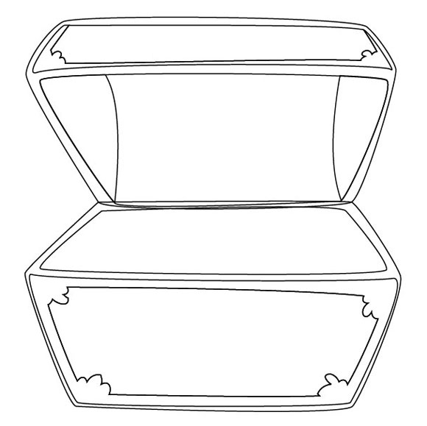
WEDNESDAY

Slide 6
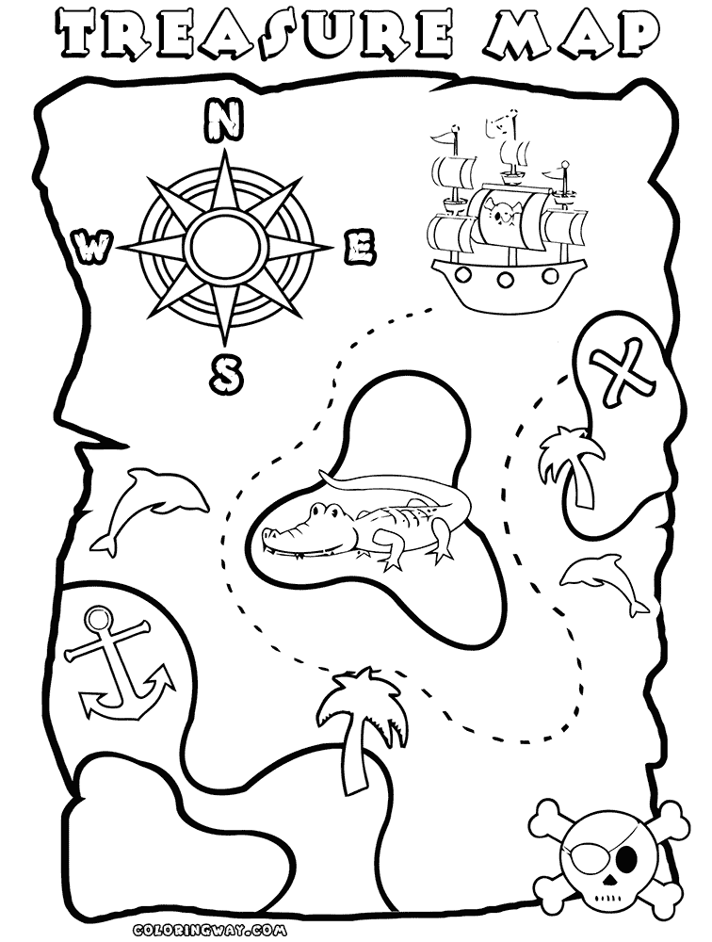
WEDNESDAY
Source: https://coloringhome.com/coloring-page/1716280?album=pirate-map-coloring-pages-printable

Slide 7
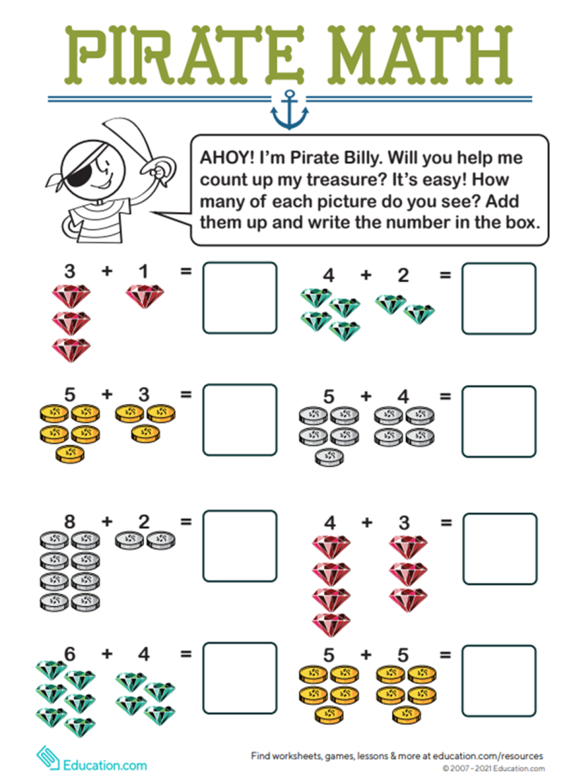
THURSDAY

Slide 8
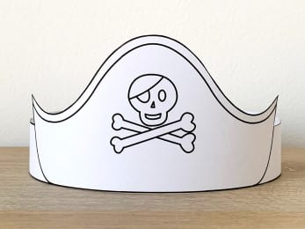
THURSDAY
https://www.happypapertime.com/downloads/pirate-paper-hat-for-coloring/

Slide 9
FRIDAY

Slide 10
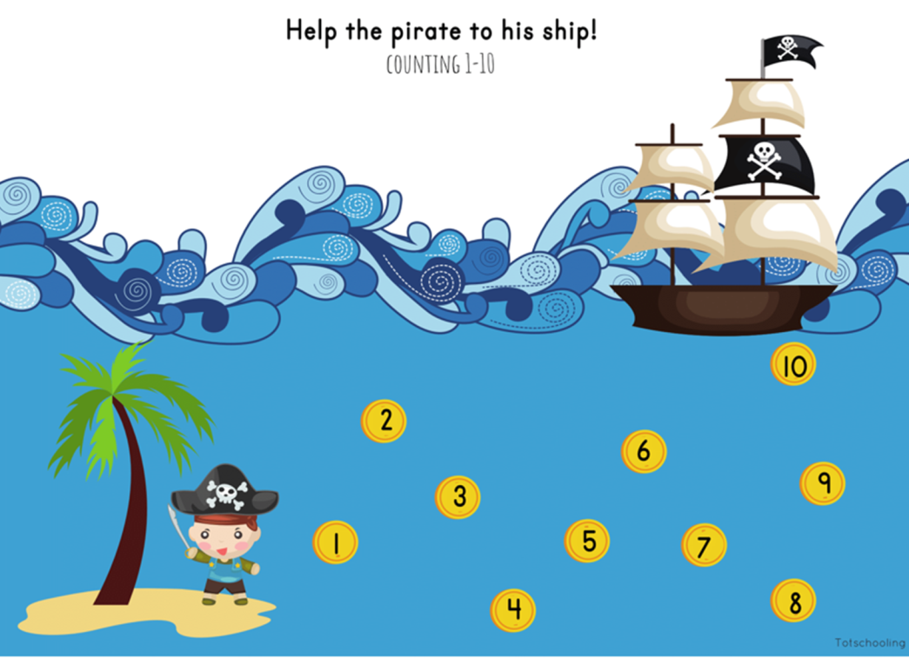
FRIDAY
Source: https://www.totschooling.net/2019/04/pirate-theme-skip-counting.html

