Slide 1
Weekly Lesson Plan THEME: Ocean
 | Theme & Letter | Language & Literacy | Math | Music & Movement | ART | Story Time | Sharing Time
MON | Intro to Ocean theme O is for Ocean Letter O sound Write letter O Decorate –blue water color | Vowel O makes two sounds long o and short o Long o – ocean Short o - octopus Short o/Long o game | Dolphin Number Line https://www.primarythemepark.com/2020/07/adding-and-subtracting-on-a-number-line/ | Move like Ocean Animals song https://youtu.be/nQLWJQqBm44?t=13 | Whale blow art https://www.primarythemepark.com/2020/08/whale-art-project-for-kindergarten-and-first-grade/ | I’m the Biggest Thing in the Ocean by Kevin Sherry | Have you ever been to the ocean/beach?
TUE | D is for Doo doo doo doo (like in the song) Letter D sound Write letter D Decorate with teeth | Sh is for shark Game: Swim away from shark (shark puppet) D as in Doodoodoodoo…shark! | Feed the Shark Subtraction | Baby Shark song and motions https://youtu.be/A7Fji3IgNfw?t=18 | Clothes pin Shark craft https://funfamilycrafts.com/clothespin-shark/ | Three Little Fish and the Big Bad Shark by Ken Geist | Swim away from the shark activity
WED | N is for Narwhal Letter N sound Write letter N Game: Headbanz | Wh is for whale | 10 Narwhal Number Words (1-10) https://www.teacherspayteachers.com/Product/Numbers-in-Word-Form-up-to-10-Narwhal-Boom-Cards-Distance-Learning-6533478?st=5a610a2d5e9d157d7a2feca89b81bb12 | Old McDonald Had an Ocean song and motions https://www.youtube.com/watch?v=DUp5N3KUDQ0 | Narwhal cut and paste picture | Not Quite Narwhal | Would you like to see a Narwhal? How are narwhals and unicorns alike/different?
TH | J is for Jelly fish Letter J sound Write letter J Game: Jump | Blending Ja Je Ji Jo ju | Jellyfish Addition | Jellyfish song https://www.youtube.com/watch?v=494e4txpwSg | Paper plate jellyfish | Peanut Butter and Jellyfish by Jarrett Kosoczka | What is your favorite ocean animal?
FRI | U is for Under the Sea Letter U sound Write letter U | CVC Under the Sea https://www.teacherspayteachers.com/Product/CVC-Words-Boom-Cards-Ocean-Summer-Theme-Digital-Distance-Learning-5689040 | Under the Sea worksheet | Under the Sea song with motions https://youtu.be/GC_mV1IpjWA?t=15 | Ocean in a bottle craft (water bottle) | The Little Mermaid book | Show-N-Tell

Slide 2
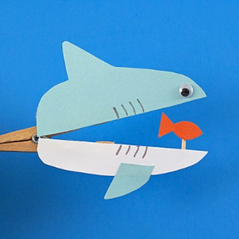
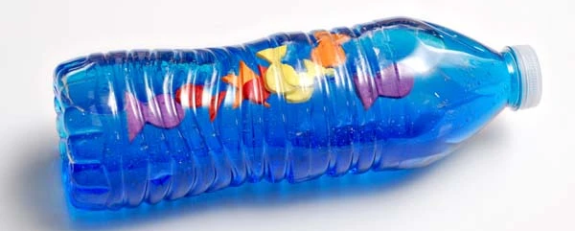
SUPPLY LIST: (Optional - for your convenience)
Monday –
Whale printable, straw, blue paint, crayons/markers/colored pencils
Tuesday –
Clothespin, blue paper, white paper, orange paper,
black marker, wiggly eye (optional)
Wednesday –
Narwhal printable, scissors, glue, crayons/markers/colored pencils
Thursday –
paper plate, marker/crayon/paint, streamers or other
Strips that can hang down, glue/tape, googly eyes (optional)
Friday –
Water bottle filled with water, blue food coloring or paint,
items such as shells, glitter, beads, foam fish, etc.

Slide 3
Short o/Long o game:
Kids should sit if it’s short; Stand if it’s long.
Open - up
Octagon - down
Oatmeal - up
Octopus - down
Old - up
Otter - down
Off -down
October - down
Ocean - up
Oxygen - down
Ohio - up
Oak - up
Olive -down
Ostrich – down
Oval -up
You may sit down.

Slide 4
Get this worksheet here:
Source: https://www.primarythemepark.com/2020/07/adding-and-subtracting-on-a-number-line/

Slide 5
Get this worksheet here:
Source: https://www.primarythemepark.com/2020/08/whale-art-project-for-kindergarten-and-first-grade/

Slide 6
Get this printable here:
https://www.kixcereal.com/kix-cereal-clothespin-shark/
Shown smaller
Get the template at the
site above

Slide 7
Get this worksheet here:
Source: https://www.adabofgluewilldo.com/animal-alphabet-n-is-for-narwhal/

Slide 8
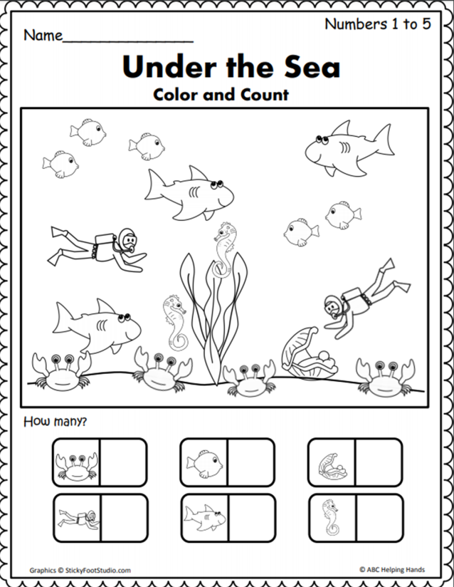
Get this worksheet here:
Source: https://www.madebyteachers.com/products/under-the-sea-counting-1-to-5/

